Slide 1


UNIT 4 HADOOP
Introduction to Hadoop – Hadoop Distributed File System – Analysing data with Hadoop – Scaling – Streaming – Clustering: Single Node and Multi Node – Working with Hadoop Commands – Working with Apache Oozie.

Slide 2
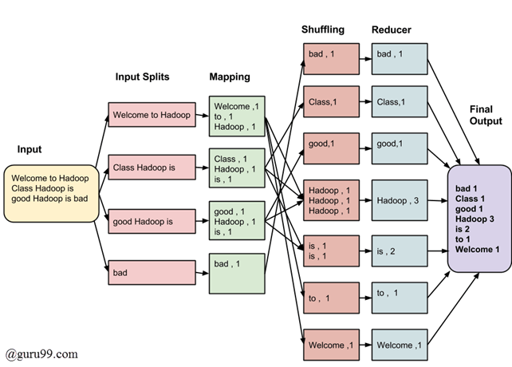
One pass computation

Slide 3

Introduction to Apache Hadoop
With the continuous business growth and start-ups flourishing up, the need to store a large amount of data has also increased rapidly.
To meet the growth of business and gain profits the companies would fetch tools to analyze the Big Data.
To meet the growing demand, Apache Software Foundation launched Hadoop, a tool to store, analyze, and process Big Data.

Slide 4

What is Hadoop?
Hadoop is an open source Java-based framework for big data processing.
It is a tool used to store, analyze and process Big Data in the distributed environment.
The Hadoop is an open source project of Apache Software Foundation and was originally created by Yahoo in 2006.
Since then, this open source project has brought revolution in Big Data analytics and taken over the Big Data market.
In simple terms, Apache Hadoop is a tool used to handle big data.
It is used to work on large sets of data distributed over a number of computers using some programming languages.
Apache Hadoop is easily scalable and you can scale a number of machines through a single server.

Slide 5
Hadoop and databases
Relational databases : used for
Interactive OLAP analysis.
multistep ACID Transactions.
100% SQL compliance
Hadoop : used for
Structured or unstructured
Scalability of storage/compute
Complex data processing

Slide 6
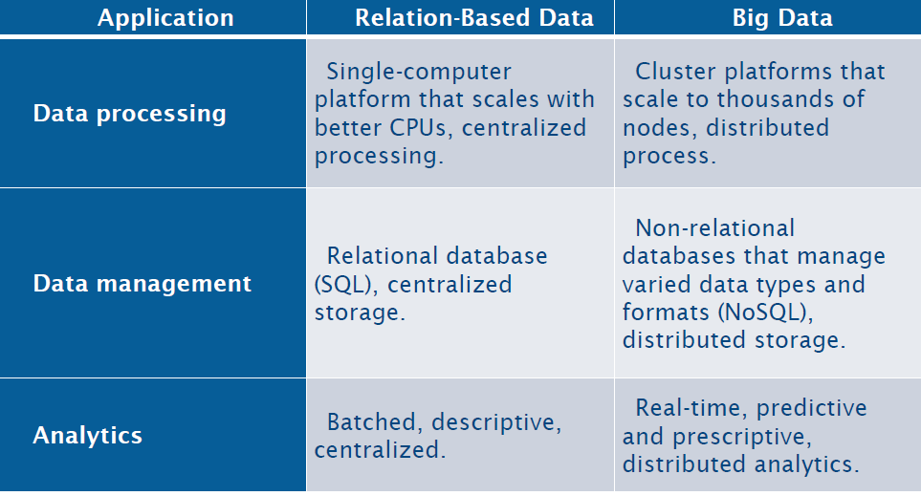
Hadoop and databases

Slide 7
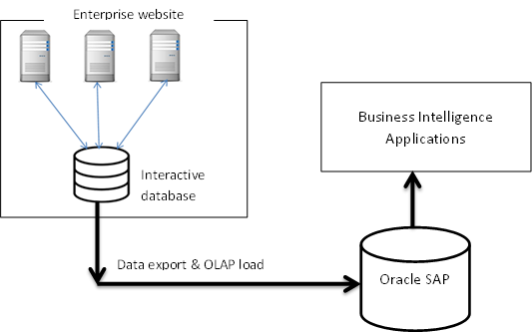
Data Center architecture without Hadoop

Slide 8
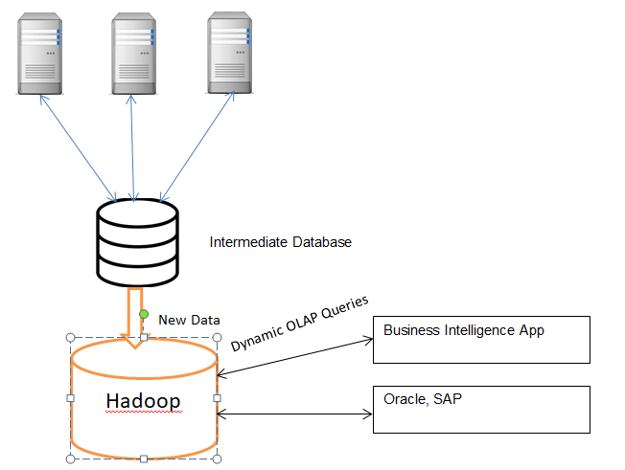
Adding Hadoop to the Mix

Slide 9
Hadoop
The most well-known technology used for Big Data is Hadoop.
Hadoop is a software framework for distributed processing of large datasets across large clusters of computers.
Hadoop is open-source implementation for Google MapReduce.
Hadoop is based on a simple programming model called MapReduce.
Hadoop has won Terabyte Sort Benchmark.
One of Yahoo's Hadoop clusters sorted 1 terabyte of data in 209 seconds.

Slide 10
Hadoop – The Various Forms Today
Apache Hadoop – Native Hadoop Distribution from Apache Foundation
IBM Infosphere – IBM Toolkit
Project Serengeti – Vmware’s Implementation of Hadoop on Vcenter
CDH – Hadoop Distribution from Cloudera
HDP – Hadoop Platform from Hortonworks
GreenPlum Hadoop – Hadoop Distribution from EMC
Yahoo! Hadoop – Hadoop Distribution of Yahoo
And More …
Apache Zookeeper
Apache Tomcat

Slide 11
Why Hadoop?
Move beyond rigid legacy frameworks.
Hadoop handles any datatype, in any quantity
Structured, Unstructured
Schema, no schema
High volume, low volume
All kinds of analytic applications
Hadoop grows with your business
Proven at petabyte scale
Capacity and performance grow simultaneously
Leverages commodity hardware to mitigate costs
Hadoop is 100% Apache ® licensed and open source
No vendor lockin
Community

Slide 12
Why Hadoop?
Hadoop helps you derive the complete value of all your data
Drives revenue by extracting value from data that was previously out of reach
Controls costs by storing data more affordable than any other platform

Slide 13
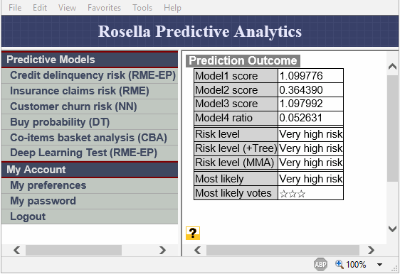
How does Hadoop help?
Eight Common Hadoop-able Problems
Modeling true risk
Challenge:
How much risk exposure does an organization really have with each customer? Multiple sources of data and across multiple lines of business
Solution with Hadoop:
Source and aggregate disparate data sources to build data picture e.g. credit card records, call recordings, chat sessions, emails, banking activity
Structure and analyze:
Sentiment analysis, graph creation, pattern recognition Typical
Typical Industry:
Financial Services (banks, insurance companies)

Slide 14
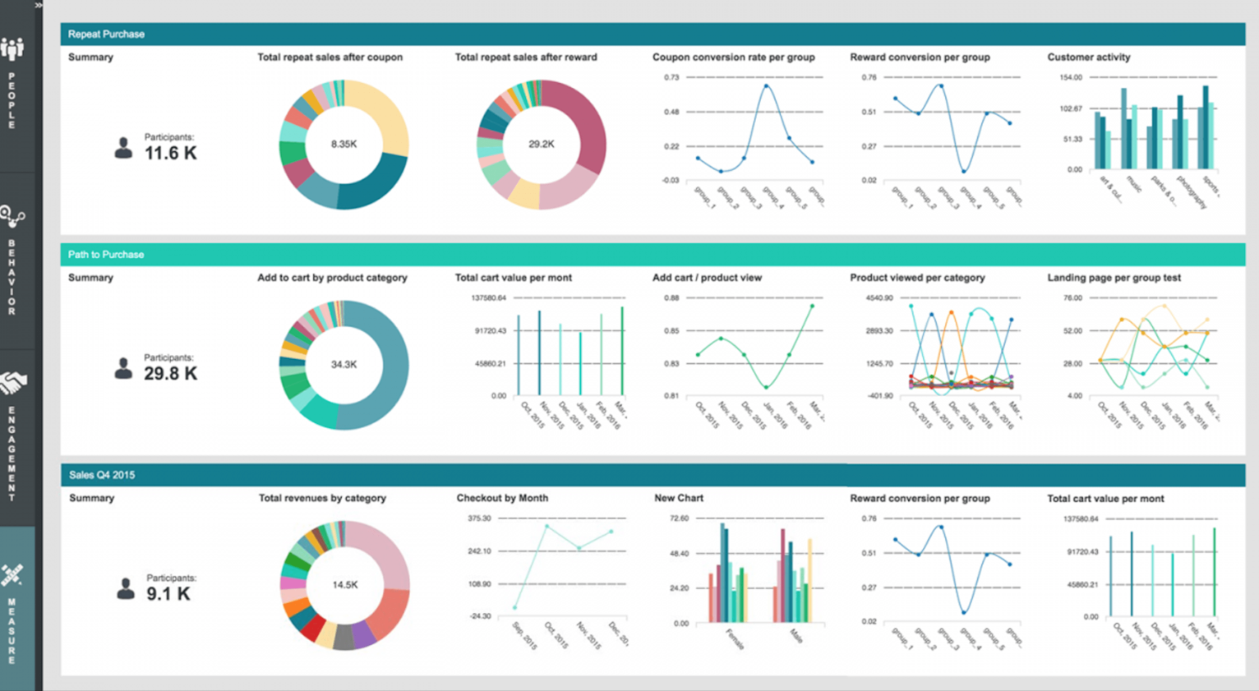
How does Hadoop help?
2. Customer churn analysis
Challenge:
Why is an organization really losing customers?
Data on these factors comes from different sources
Solution with Hadoop:
Rapidly build behavioral model from disparate data sources
Structure and analyze with Hadoop
Traversing
Graph creation
Pattern recognition
Typical Industry:
Telecommunications, Financial Services

Slide 15

Contn…
3. Recommendation engine
Challenge:
Using user data to predict which products to recommend
Solution with Hadoop:
Batch processing framework
Allow execution in parallel over large datasets
Collaborative filtering:
Collecting ‘taste’ information from many users
Utilizing information to predict what similar users like
Typical Industry:
Ecommerce, Manufacturing, Retail – Advertising

Slide 16
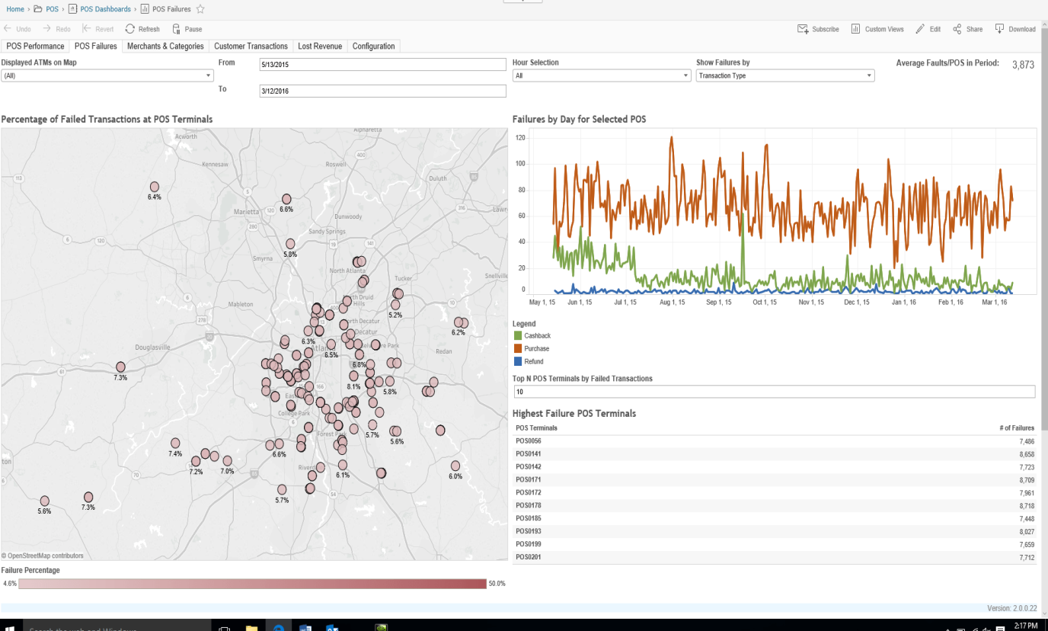
Contn…
4. PoS transaction analysis
Challenge:
Analyzing Point of Sale (PoS) data to target promotions and manage operations
Sources are complex and data volumes grow across chains of stores and other sources
Solution with Hadoop:
Batch processing framework
Allow execution in parallel over large datasets
Pattern recognition:
Optimizing over multiple data sources
Utilizing information to predict demand
Typical Industry:
Retail

Slide 17

Contn…
5. Analyzing Network Data To Predict Failure
Challenge:
Analyzing real-time data series from a network of sensors
Calculating average frequency over time is extremely tedious because of the need to analyze terabytes.
Solution with Hadoop:
Do the computation for the data.
Expand from simple scans to more complex data mining.
Better understand how the network reacts to fluctuations.
Discrete anomalies may, in fact, be interconnected.
Identify leading indicators of component failure.
Typical Industry:
Utilities, Telecommunications, Data Centers

Slide 18

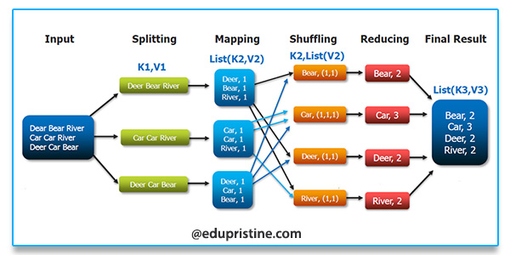
Contn…
6. Threat Analysis/ Trade Surveillance
Challenge:
Detecting threats in the form of fraudulent activity
Large data volumes involved
Like looking for a needle in a haystack
Solution with Hadoop:
Parallel processing over huge datasets
Pattern recognition to identify anomalies i.e. threats
Typical Industry:
Security, Financial Services, General: spam fighting, click fraud

Slide 19
Contn…
7. Search Quality
Challenge:
Providing real time meaningful search results
Solution with Hadoop:
Analyzing search attempts in conjunction with structured data
Pattern recognition: Browsing pattern of users performing searches in different categories
Typical Industry:
Web, Ecommerce

Slide 20
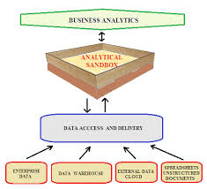
Contn…
8. Data “Sandbox”
Data Deluge:
Don’t know what to do with the data or what analysis to run
Solution with Hadoop:
“Dump” all this data into an HDFS cluster
Use Hadoop to start trying out different analysis on the data
See patterns to derive value from data
Typical Industry:
Common across all industries

Slide 21
Hadoop Infrastructure
Hadoop is a distributed system like distributed databases.
However, there are several key differences between the two infrastructures
Data model
Computing model

Slide 22
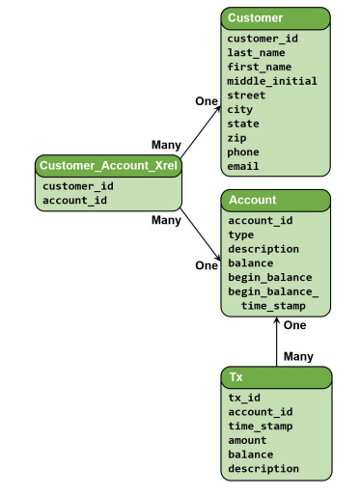
How Data Model is Different?
Distributed Databases:
• Deal with tables and relations.
• Must have a schema for data.
• Data fragmentation & partitioning.

Slide 23
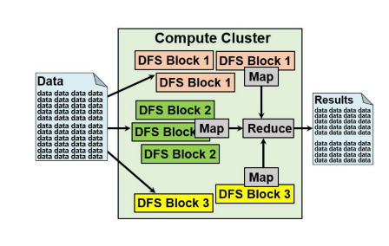
Hadoop:
• Deal with flat files in any format
• No schema for data
• Files are divide automatically into blocks

Slide 24
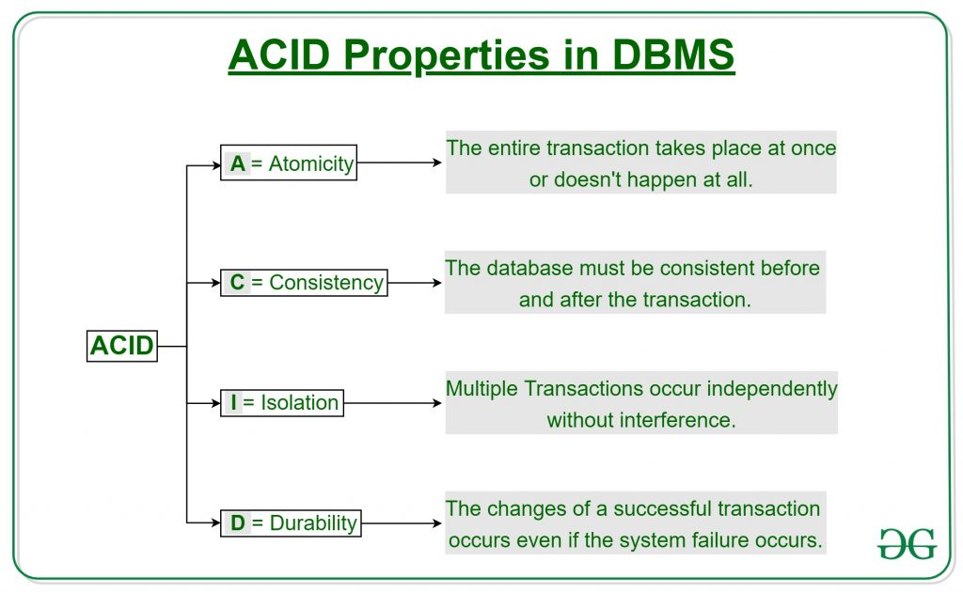
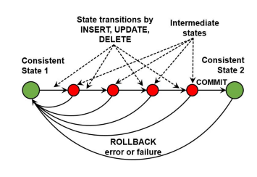
How Computing Model is Different?
Distributed Databases:
• Notion of a transaction
• Transaction properties ACID (Atomicity, Consistency, Isolation, and Durability)
• Distributed transaction

Slide 25
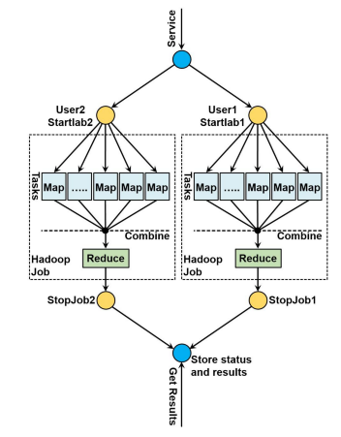
Hadoop:
• Notion of a job divided into tasks.
• Map-Reduce computing model.
• Every task is either a map or reduce.

Slide 26
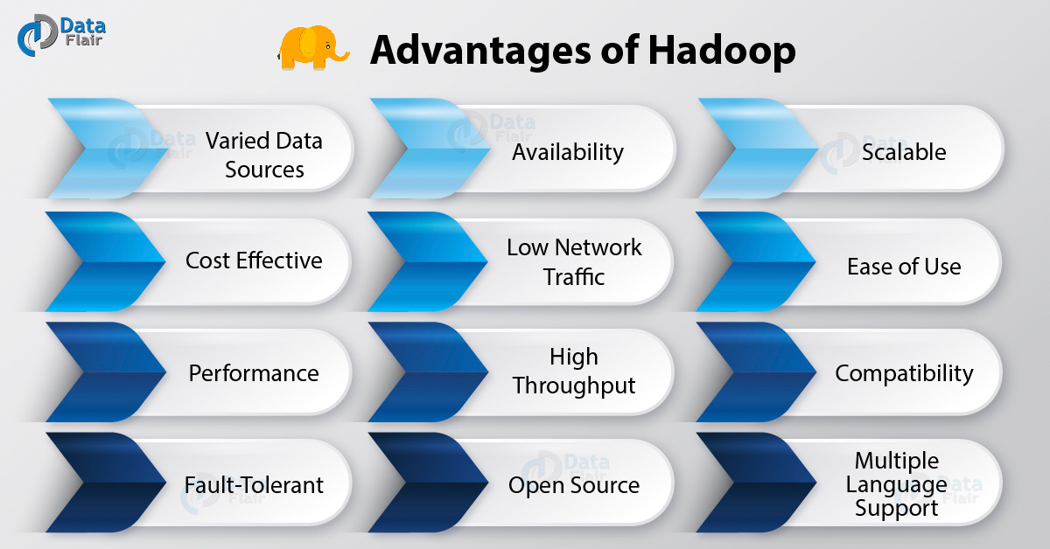
Key Benefits
Computing power
Flexibility
Fault Tolerance
Low cost
Scalability

Slide 27

Hadoop Framework
Apache Hadoop runs on Java and is an open source framework used to process and store a large amount of data on a huge cluster.
Hadoop framework is composed of four main components:
Hadoop Common
Hadoop Distributed File System
YARN
MapReduce

Slide 28
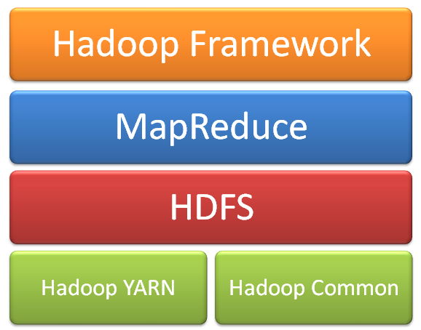
The Apache framework is composed of the following components:

Slide 29
The Apache framework is composed of the following components:
Hadoop Common:
It refers to the common Java utilities and libraries that support Hadoop modules.
Hadoop Distributed File Systems:
It is the primary storage system that Hadoop applications use.
It is a distributed file system that enables you to have an access to applications data.
Hadoop MapReduce:
Hadoop MapReduce is a software framework used for the parallel processing of big data.
Hadoop YARN:
YARN is the resource management technology used by Hadoop.
It is responsible for resource management and job scheduling

Slide 30
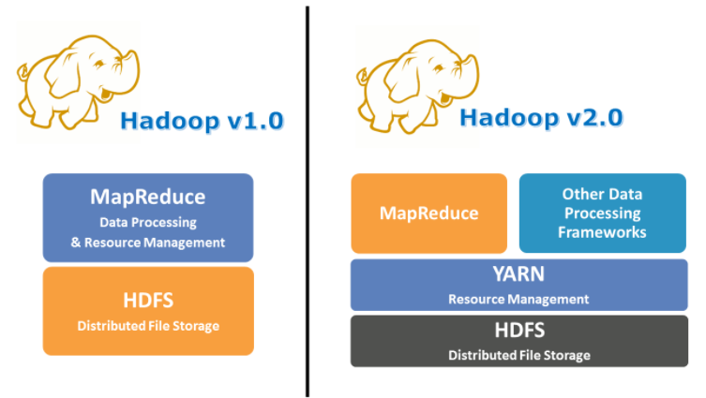
YARN (Yet Another Resource Negotiator)

Slide 31
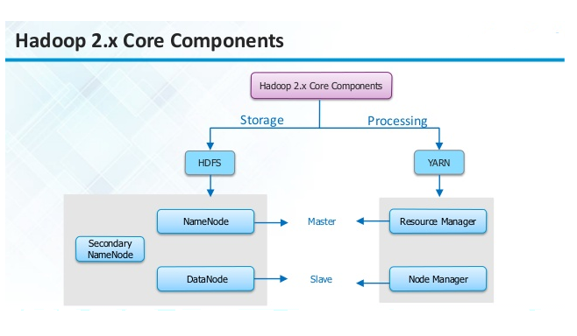
Hadoop

Slide 32
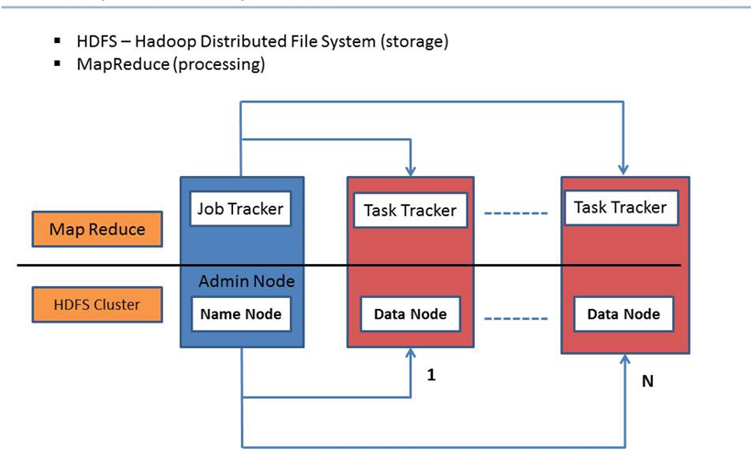
Hadoop 1.x Core Components

Slide 33
Components of Hadoop
Name Node
Executes file system namespace operations like opening, closing, and renaming files and directories.
It also determines the mapping of blocks to DataNodes.
Data Node
The DataNodes are responsible for serving read and write requests from the file system’s clients.
The DataNodes also perform block creation, deletion, and replication upon instruction from the NameNode.

Slide 34
Job Tracker
JobTracker and TaskTracker are 2 essential process involved in MapReduce execution in MRv1
JobTracker process runs on a separate node and not usually on a DataNode.
JobTracker receives the requests for MapReduce execution from the client.
JobTracker talks to the NameNode to determine the location of the data.
JobTracker finds the best TaskTracker nodes to execute tasks based on the data locality (proximity of the data) and the available slots to execute a task on a given node.
When the work is completed, the JobTracker updates its status.
Client applications can poll the JobTracker for information.

Slide 35
Task Tracker
TaskTracker runs on DataNode. Mostly on all DataNodes.
TaskTracker is replaced by Node Manager in MRv2.
Mapper and Reducer tasks are executed on DataNodes administered by TaskTrackers.
TaskTrackers will be assigned Mapper and Reducer tasks to execute by JobTracker.
TaskTracker will be in constant communication with the JobTracker signalling the progress of the task in execution.

Slide 36
Key Benefits
1. Scalable
2. Cost effective
3. Flexible
4. Fast
5. Resilient to failure

Slide 37
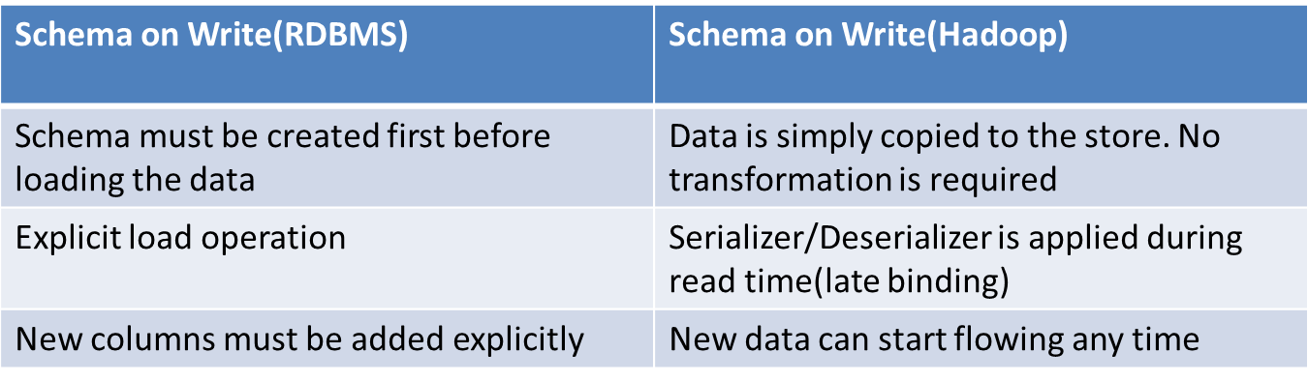
Flexibility:Complex data processing

Slide 38
Flexibility: Complex data processing
Java Map Reduce
Streaming Map Reduce
Pig Latin
Hive
Oozie

Slide 39
Java Map reduce
Flexible
But tedious development cycles
Assembly language of hadoop
The MapReduce algorithm contains two important tasks, namely Map and Reduce.
Map takes a set of data and converts it into another set of data, where individual elements are broken down into tuples (key/value pairs).

Slide 40
Streaming Map Reduce
Lower in performance than Java Map reduce
Less flexible than Java Map reduce
Allows to develop in any programming language
Hadoop streaming can be performed using languages like Python, Java, PHP, Scala, Perl, UNIX, and many more.

Slide 41
Pig Latin
High level language from Yahoo.
Suitable for batch data flow workloads
It is a tool/platform which is used to analyze larger sets of data representing them as data flows.
perform all the data manipulation operations in Hadoop using Apache Pig

Slide 42
Hive
Hive is data warehouse infrastructure that facilitates querying and analysis of large datasets residing in Apache Hadoop.
Hive provides a way to query and manipulate this data using a SQL-like language called HiveQL,
SQL interpreter by Facebook.
Included a meta store mapping files to their Schemas and SerDes-Serializer/DeSerializer

Slide 43
Oozie
PDL-XML workflow engine(PDL-Perl Data Language)
Oozie is a workflow scheduler system to manage Apache Hadoop jobs.
Oozie Workflow jobs are Directed Acyclical Graphs (DAGs) of actions.

Slide 44
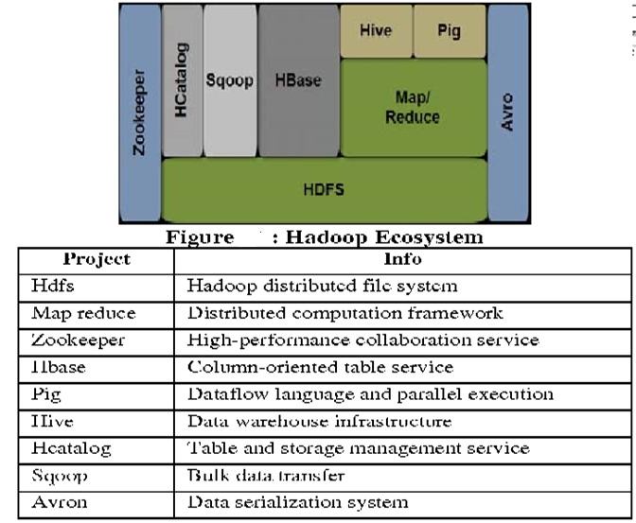
Hadoop Ecosystem

Slide 45
Hadoop Framework
There are 2 Main layers:
HDFS
Execution Enginer

Slide 46
Hadoop Distributed File System-HDFS

Slide 47
Hadoop Distributed File System-HDFS
HDFS is a virtual File system
File System is split into many small files
Each small file is replicated and stored on 3 servers for fault tolerance constraints
Hadoop Mapreduce is a way to split every request into smaller requests sent to small servers
Small servers allow scalable use of CPU power

Slide 48
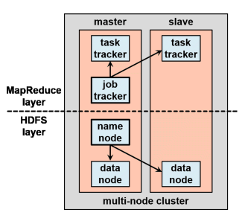
Hadoop Distributed File System-HDFS

Slide 49
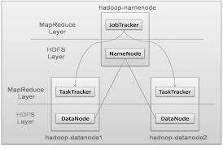
Hadoop Distributed File System-HDFS

Slide 50
Hadoop Distributed File System-HDFS
• HDFS + MapReduce are enough to have things working.
• Examples:
Word Count
• Job: Count the occurrences of each word in a data set

Slide 51
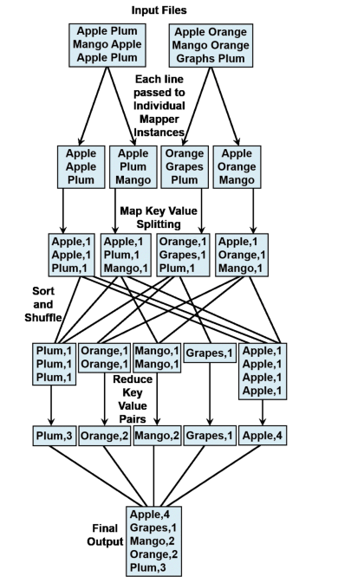
Ex:Wordcount

Slide 52
Namenode
Single node in cluster
Brain of HDFS
Hadoop employs master/slave architecture for both distributed storage and distributed computation
Distributed Storage system is HDFS
Namenode is the master of HDFS that directs slave datanode to perform low level tasks

Slide 53
Namenode as book Keeper of HDFS
Namenode list of all blocks of file and list of all data nodes that contains the block
It keeps track of how files are stored into file blocks, which nodes store these blocks and overall health of HDFS
The function of namenode is memory and IO intensive
The server hosting namenode doesn’t store any user data or perform any computation

Slide 54
Name node - Drawback
Name node is the Single point of failure in Hadoop cluster
For other data nodes, if their host node fails due to h/w or s/w reasons, the Hadoop cluster will continue smoothly

Slide 55
Data Nodes
Each slave machine in the cluster will host a data node to perform the granted work of Distributed File System
Reading and writing HDFS blocks to actual files on local file system
During r/w a HDFS file, the file is broken into blocks and Namenode will tell the client which data node each block resides in.

Slide 56
Data Nodes
Client communicates directly with the datanodes to process local files corresponding to the blocks
Data node may communicate with other datanodes to replicate data blocks for redundancy

Slide 57
Data Replication
HDFS is designed to reliably store very large files across machines in a large cluster.
It stores each file as a sequence of blocks; all blocks in a file except the last block are the same size.
The blocks of a file are replicated for fault tolerance.
The block size and replication factor are configurable per file.

Slide 58
Data Replication
An application can specify the number of replicas of a file.
The replication factor can be specified at file creation time and can be changed later.
Files in HDFS are write-once and have strictly one writer at any time.
The NameNode makes all decisions regarding replication of blocks.

Slide 59
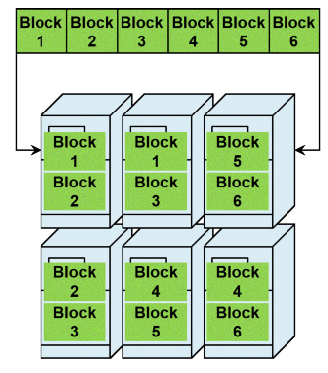
Data Replication

Slide 60
Heartbeat and Block report of data nodes
Namenode periodically receives a Heartbeat and a Blockreport from each of the DataNodes in the cluster
Receipt of a Heartbeat implies that the DataNode is functioning properly
A Blockreport contains a list of all blocks on a DataNode

Slide 61
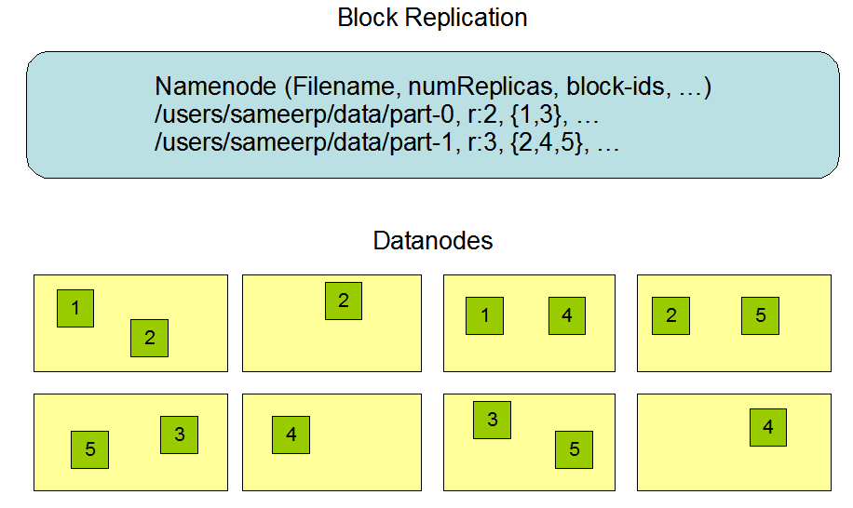

Slide 62
Data Replication
Distributed File System and Replication
Files in HDFS are "write once" files: input data is streamed or loaded into HDFS and processed by the MapReduce framework, and any generated results are stored back in HDFS.
The original input data is not modified during its life in HDFS.
With this approach, HDFS is not intended to be used as a general-purpose file system.
To enhance reliability and availability of the data in HDFS, the data assigned to one node is replicated among the other nodes.
The default replication is threefold. This replication helps ensure that the data can survive the failure or non-availability of a node.

Slide 63
Data Replication
When the replication factor is three, HDFS’s placement policy is to put:
1.one replica:
on the local machine if the writer is on a datanode,
otherwise on a random datanode,
2.another replica on a node in a different (remote) rack,
3. last on a different node in the same remote rack.

Slide 64
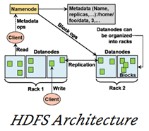
Default placement policy: Where to put a given block?
First copy is written to the node creating the ﬁle (write afﬁnity).
Second copy is written to a data node within the same rack.
Third copy is written to a data node in a different rack.

Slide 65
Replication factor >3
If the replication factor is greater than 3, the placement of the 4th and following replicas are determined randomly while keeping the number of replicas per rack below the upper limit (which is basically (replicas - 1) / racks + 2)

Slide 66
Datanodes and Namenodes
Datanodes constantly report to namenode
Upon initialization, each datanode informs namenode of the blocks it is currently storing
After mapping, the datanode continually poll the namenode to provide information regarding local changes and receive instructions to create, move or delete blocks from local disk.

Slide 67
Secondary Name Node(SNN)
SNN is an assistant daemon for maintaining the state of clusters HDFS
Like namenode, each cluster has on SNN
SNN doesnot receive or record any realtime changes to HDFS
SNN communicates with namenode to take snapshots of HDFS meta data at intervals defined by cluster configuration

Slide 68
Secondary Name Node(SNN)
Namenode is a single point of failure for hadoop clusters and SNN snapshots help minimize the downtime and loss of data.
Namenode failure requires human intervention to reconfigure the cluster to use SNN as primary Namenode

Slide 69
Job Tracker
Job tracker is the master overseeing the overall execution of mapreduce job.
Job tracker is a liaison between the client application and hadoop
Once the client submits the code to the cluster the JobTracker determines the execution plan by determining which files to process
Assigns nodes to different tasks and monitors all tasks as they are running
If a task fail, the job tracker will automatically relaunch the task on a different node

Slide 70
Task Tracker
Task trackers manages the execution of individual tasks
Task tracker can spawn multiple JVMs to handle many map/reduce tasks in parallel
Main responsibility is to constantly communicate with Job tracker

Slide 71
Task Tracker
If Job tracker fails to receive a heartbeat from tasktracker within the specified amount of time, it will assume task tracker has crashed and will resubmit the corresponding tasks to other nodes in the cluster

Slide 72
Client
Job Tracker
Task Tracker
Task Tracker
Task Tracker
Map
Map
Map
Reduce
Reduce
Reduce

Slide 73
Secondary Name Node
Name Node
Job Tracker
Data Node
Task Tracker
Data Node
Task Tracker
Data Node
Task Tracker

Slide 74
HDFS Files and Blocks

Slide 75
HDFS
HDFS is the first building block of hadoop cluster
HDFS breaks incoming files into blocks and stores them redundantly across the cluster
To efficiently process massive amounts of data, it is important to move
A single large file splits into blocks and blocks are distributed among the nodes of hadoop cluster

Slide 76
HDFS
The blocks used in HDFS are large 128 MB or more compared to small blocks associated with traditional file systems
This allows the system to scale without increasing the size and complexity of HDFS metadata
Files in HDFS are write once files
Input data is loaded into HDFS and processed by Mapreduce framework

Slide 77
HDFS Files and Blocks
Files are stored as collection of blocks
Blocks are the minimum amount of data that can be read or written
Blocks details are stored in 3 nodes
Namenode-Manages metadata about files and blocks
SNN-Holds backup of NN data
Datanode- Store and serve blocks

Slide 78
Data Loading techniques

Slide 79
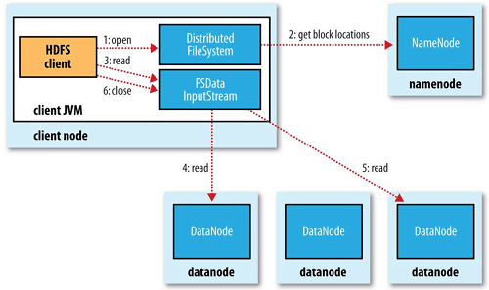
HDFS READS

Slide 80
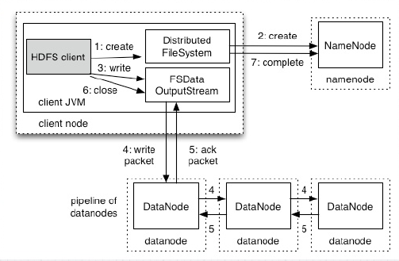
HDFS Writes

Slide 81
Map Reduce
Map reduce is a programming model for expressing distributed computations at a massive scale
It is an execution framework for organizing and performing such computation

Slide 82
Typical Large Data Problem
Map
Iterate over large number of records
Extract data of interest
Shuffle and sort intermediate results
Reduce
Aggregate intermediate results
Generate final output

Slide 83
Map Reduce model
Basic notion of Mapreduce is to divide a task into subtasks, handle subtasks in parallel and aggregate the results of sub tasks to form the final output
Programs written in mapreduce are automatically parallelized and programmers not need to be concerned about the implementation details of parallel processing

Slide 84
MapReduce functions
Map()
Reduce()
Map Phase:
Reads input(in parallel) and distributes data to reducers
Auxiliary phase such as sorting, partitioning and combining values can also take place between map and reduce phases.

Slide 85
Map Reduce programs are used to process large files
Input and Output for map and reduce functions are expressed in the form of (Key, Value) pairs
Hadoop MapReduce program has a component called Driver
Driver is responsible for executing the code on the specified input file and controlling the location which the output files are placed.

Slide 86
Map Input
Map(inkey, invalue)→ list(intermediate key, intermediate value)
Purpose of map phase is to organize data in preparation for processing done in reduce phase
Input to map function is in the form of (key, value) pairs, eventhough the input to MapReduce program is a file or files.

Slide 87
Map
Value: data record
Key: Offset of data record from the beginning of the file
Output: Collection of Key value pairs which are inputs for reduce function
Eg. Wordcount Problem
Mapper can run several identical mappers in parallel

Slide 88
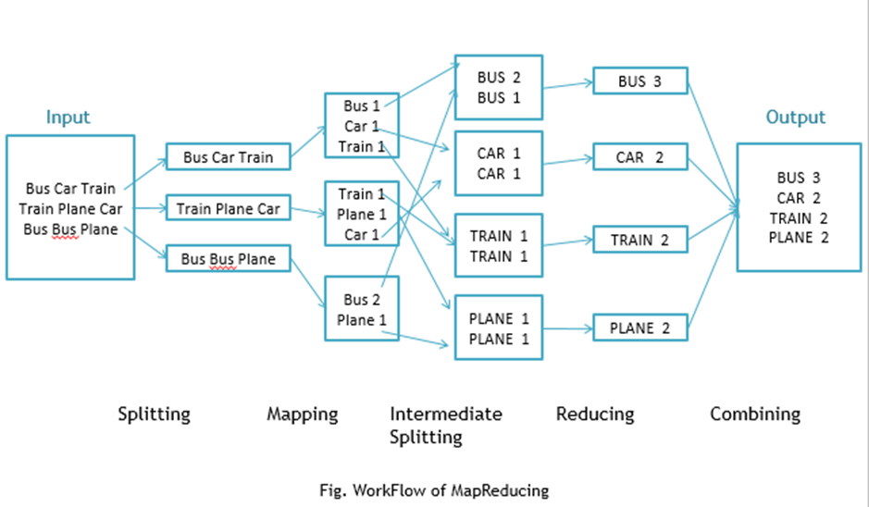
Map Reduce Example

Slide 89
Reduce
Reduce(intermediate key, list(intermediate value)
List(outkey, out value)

Slide 90
Reduce
Reduce function processes intermediate values for particular key generated by map function and generates the output
One to one mapping between keys and reducers
Several reducers can run in parallel. Independent of each other
No. of reducers decided by the user
Default no. of reducers is 1

Slide 91
Hadoop Cluster Architecture
Cluster: Loosely/Tightly connected computers work together as a single system
Hadoop Cluster: Storing & analysing large amount of unstructured data in distributed environment
These clusters run on low cost on commodity computers

Slide 92
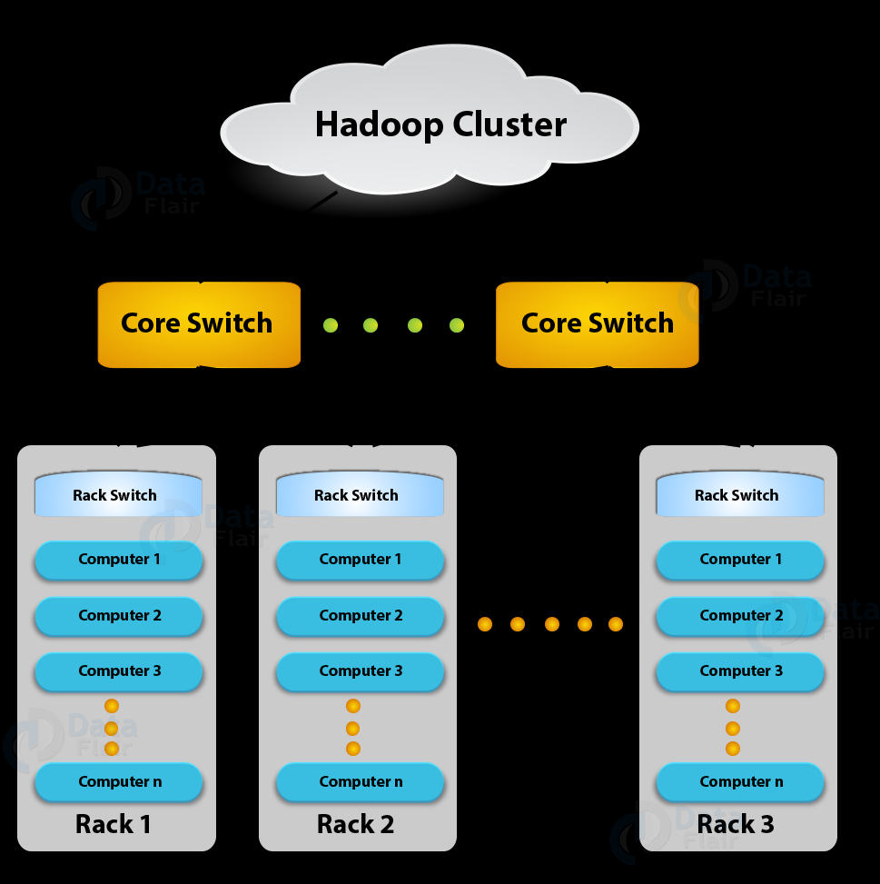
Hadoop Cluster architecture

Slide 93
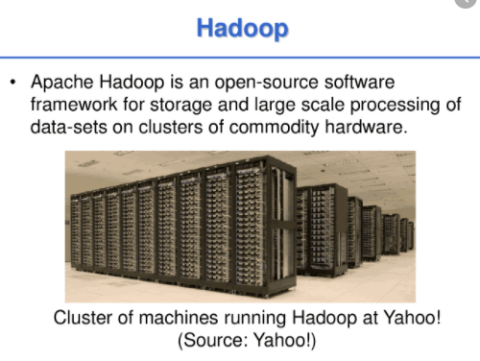
Hadoop Cluster architecture- The Real time set up

Slide 94
Hadoop Cluster architecture as Share nothing systems
Nodes share only the networks that connects them
Large hadoop clusters are arranged in several racks
Network traffic between different nodes in the same rack is much more desirable than network traffic across the racks
Eg. Hadoop cluster set up for 4500 nodes

Slide 95
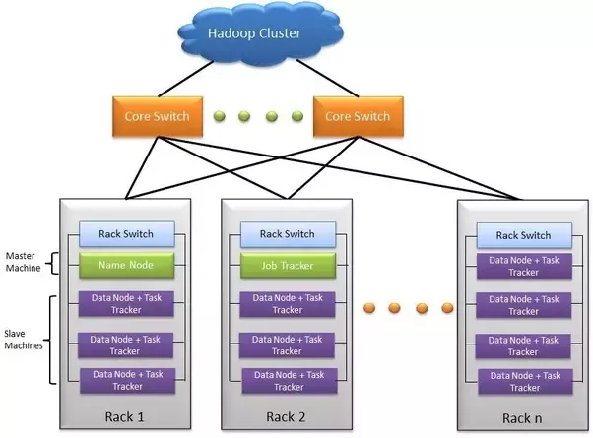
In this Hadoop cluster
110 different racks
Each rack has 40 slave machines

Slide 96
Rack Description
At the top of each rack there is a rack switch
Each slave machine has cables coming out from both the ends
Cables are connected to rack switch at the top which means that top rack switch will have around 80 ports
There are global 8 core switches
The rack which has uplinks connected to core switches and hence connecting all other racks with uniform bandwidth forming the cluster

Slide 97
In the cluster, few machines act as namenodes and JobTracker
They are referred to as Masters
Masters have different configuration for more DRAM and CPU and less storage
The majority of machine acts as data node and Task trackers are referred as slaves
These slave nodes have lots of local disk storage and moderate amounts of DRAM and CPU

Slide 98
NameNode and DataNode communication
NameNode and DataNode communication: Heartbeats.
DataNodes send heartbeats to the NameNode to confirm that the DataNode is operating and the block replicas it hosts are available.

Slide 99
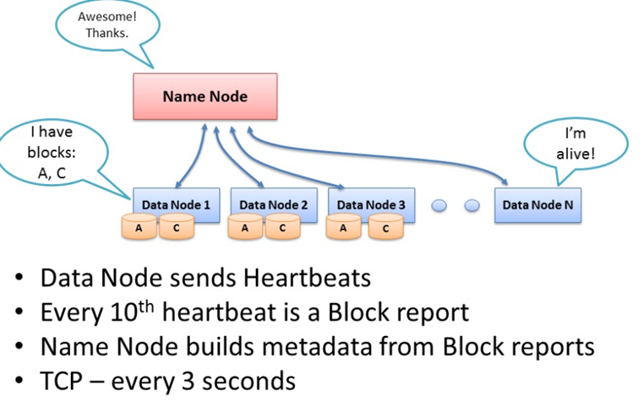

Slide 100
Blockreports
A DataNode identifies block replicas in its possession to the NameNode by sending a block report. A block report contains the block id, the generation stamp and the length for each block replica the server hosts.
Blockreports provide the NameNode with an up-to-date view of where block replicas are located on the cluster and nameNode constructs and maintains latest metadata from blockreports.

Slide 101
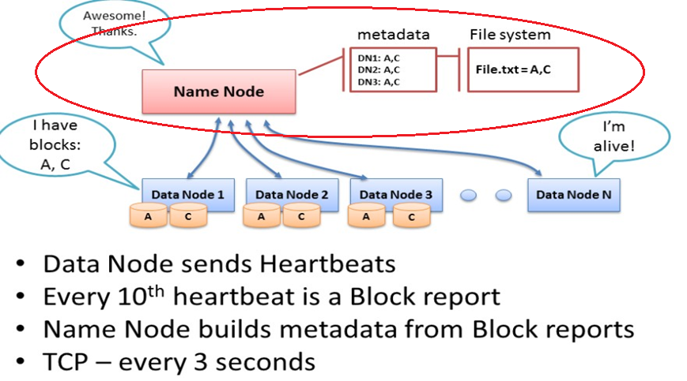

Slide 102
Failure recovery
The NameNode does not directly call DataNodes. It uses replies to heartbeats to send instructions to the DataNodes. The instructions include commands to:
 replicate blocks to other nodes:
DataNode died.
copy data to local.
 remove local block replicas;
 re-register or to shut down the node;

Slide 103
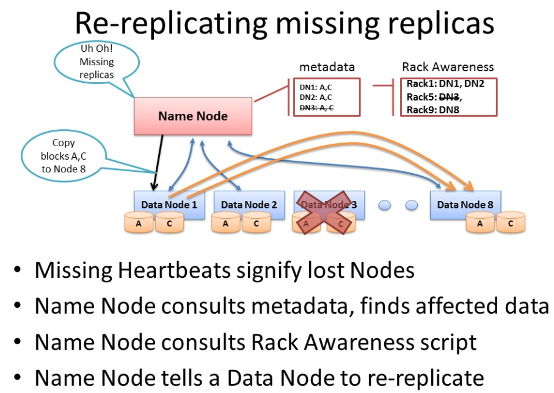

Slide 104
Hadoop configuration files
Hadoop configuration is driven by two types of important configuration files:
Read-only default configuration - src/core/core-default.xml, src/hdfs/hdfs-default.xml and src/mapred/mapred-default.xml.
Site-specific configuration - conf/core-site.xml, conf/hdfs-site.xml and conf/mapred-site.xml.

Slide 105
Configuring the Environment of the Hadoop Daemons
Daemon | Configure Options
NameNode | HADOOP_NAMENODE_OPTS
DataNode | HADOOP_DATANODE_OPTS
SecondaryNamenode | HADOOP_SECONDARYNAMENODE_OPTS
JobTracker | HADOOP_JOBTRACKER_OPTS
TaskTracker | HADOOP_TASKTRACKER_OPTS

Slide 106
Configuring the Hadoop Daemons
Specified in conf/core-site.xml:
conf/hdfs-site.xml:
Parameter | Value
fs.default.name | URI of NameNode.
Parameter
dfs.name.dir | Path on the local filesystem where the NameNode stores the namespace and transactions logs persistently.
dfs.data.dir | Comma separated list of paths on the local filesystem of aDataNode where it should store its blocks.

Slide 107
conf/mapred-site.xml:
Parameter | Value
mapred.job.tracker | Host or IP and port of JobTracker.
mapred.system.dir | Path on the HDFS where the MapReduce framework stores system files e.g. /hadoop/mapred/system/.
mapred.local.dir | Comma-separated list of paths on the local filesystem where temporary MapReduce data is written.
mapred.tasktracker.{map|reduce}.tasks.maximum | The maximum number of MapReduce tasks, which are run simultaneously on a given TaskTracker, individually.
dfs.hosts/dfs.hosts.exclude | List of permitted/excluded DataNodes.
mapred.hosts/mapred.hosts.exclude | List of permitted/excluded TaskTrackers.
mapred.queue.names | Comma separated list of queues to which jobs can be submitted.
mapred.acls.enabled | Boolean, specifying whether checks for queue ACLs and job ACLs are to be done for authorizing users for doing queue operations and job operations

Slide 108
conf/mapred-queue-acls.xml
Parameter | Value
mapred.queue.queue-name.acl-submit-job | List of users and groups that can submit jobs to the specified queue-name.
mapred.queue.queue-name.acl-administer-jobs | List of users and groups that can view job details, change the priority or kill jobs that have been submitted to the specified queue-name.

Slide 109
Hadoop Cluster Modes
Standalone mode
Single node cluster/Pseudo distributed mode
Multi node cluster/ Fully Distributed mode

Slide 110
Standalone mode
Default mode
HDFS is not utilized in this mode
Local file system is used for input and output
Used for debugging purpose
No custom configuration is required in 3 hadoop files
mapred- site.xml
core-site.xml
hdfs-site.xml
Standalone mode is much faster than pseudo distributed mode

Slide 111
Pseudo distributed mode
Configuration is required in given 3 files
Replication factor is one for HDFS
Here, one node is used as Master node/data node/Job tracker/Task tracker
Used for real code to test in HDFS
Pseudo distributed cluster is a cluster where all daemons are running on one node itself

Slide 112

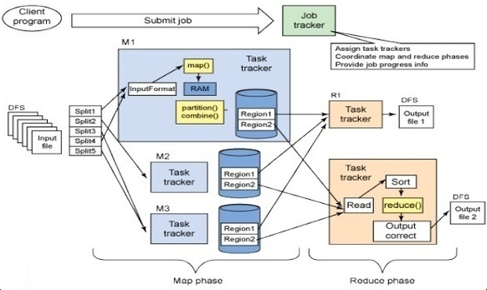
How does Hadoop Work?

